Slide 1

PCF Basics & Tooling

Slide 2
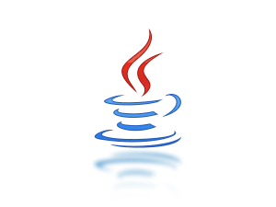



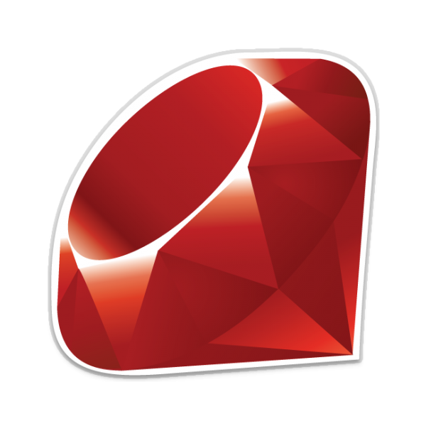
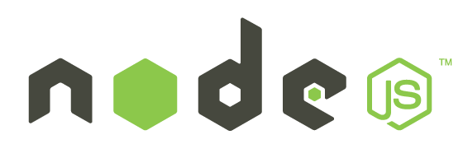


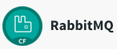
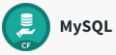

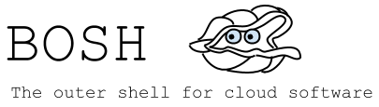
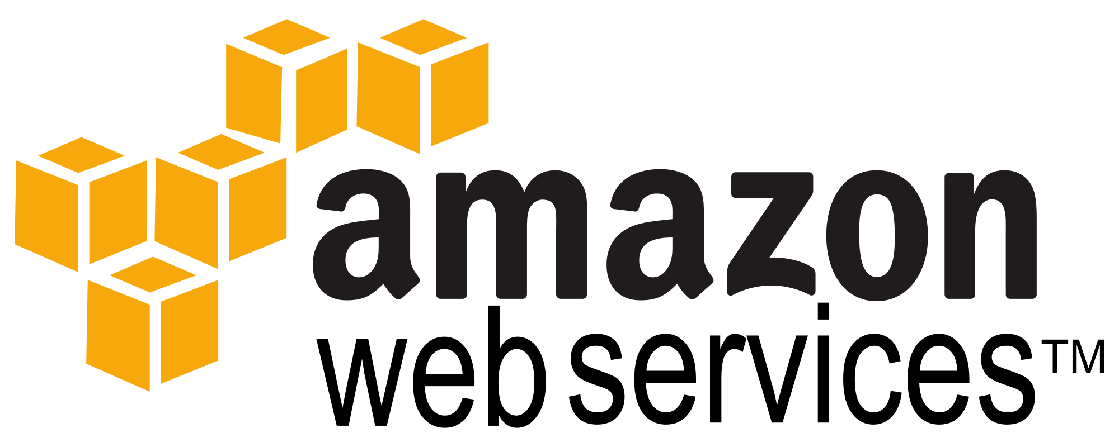
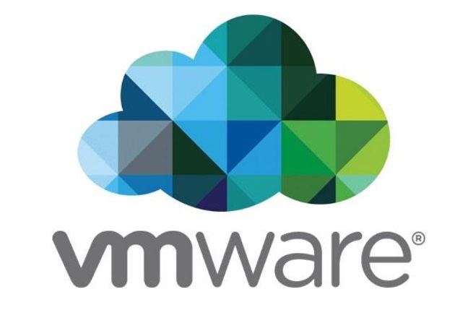

Roles
Pivotal Cloud Foundry
Tools
Applications
more…
Dev
Contract: 12 Factor App
Runtime Platform
Services
Dev
IT Ops
Cloud Foundry
Contract: BOSH Release
Operations
(Infrastructure Automation)
IT Ops
BOSH
Contract: Cloud Provider Interface
Infrastructure
AWS
VMWare
OpenStack
IT Ops
Notes:
And all of this is enforced through strict API contracts that allow you to go FAST and be safe.

Slide 3
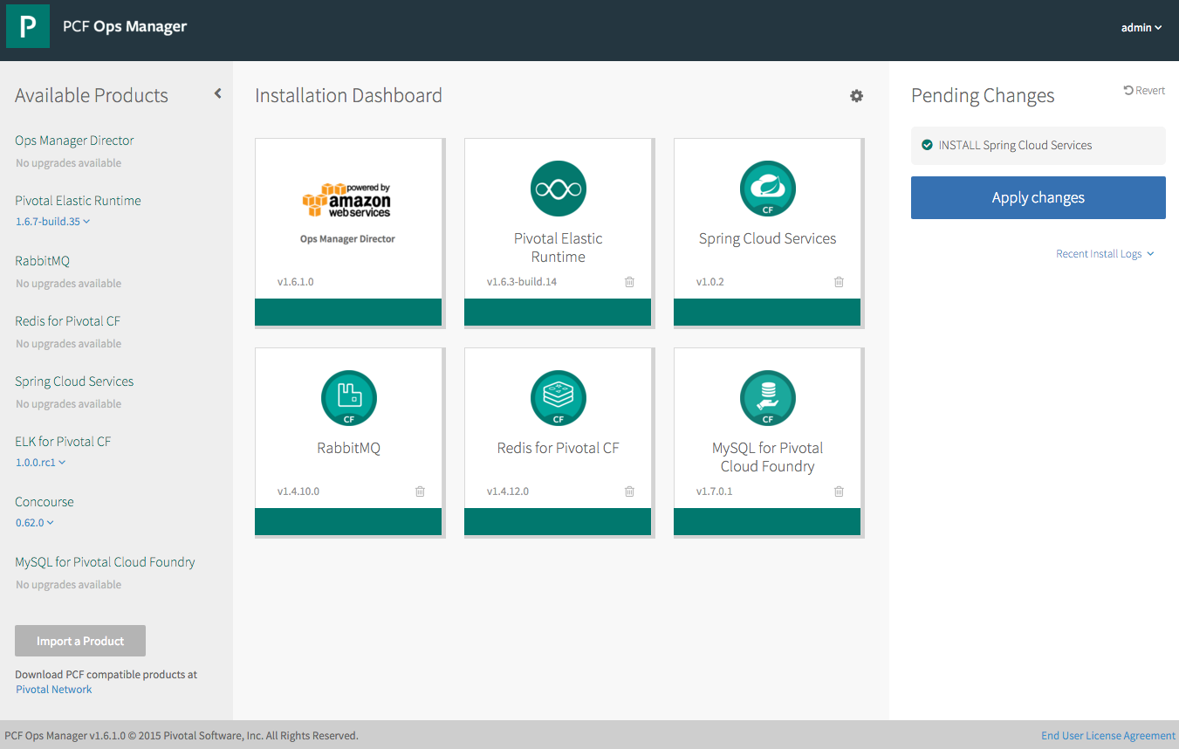
Operations - Pivotal Ops Manager
Click to Install the Platform
Built-in High Availability
Install and Manage Services
Handle Live upgrades and updates
Click to scale the platform
Built-in Platform monitoring
Notes:
http://docs.pivotal.io/pivotalcf/customizing/index.html
This picture allows us to walk thru Ops Manager. Left hand size you see some products that are not installed, you even see a new version of Elastic Rutnime (upgrades) and the Pending Changes (INSTALL Spring Cloud Services). You can talk about important products and the recent logs.
We have the Ops Director for AWS (but we support others). This is the very first tile you install and established the communication with the IaaS. Then you probably start with the Elastic Runtime, now you have a platform – basic platform services including the container runtime (DIEGO). Then you install additional services. All managed by bosh and done in a consistent manager.

Slide 4
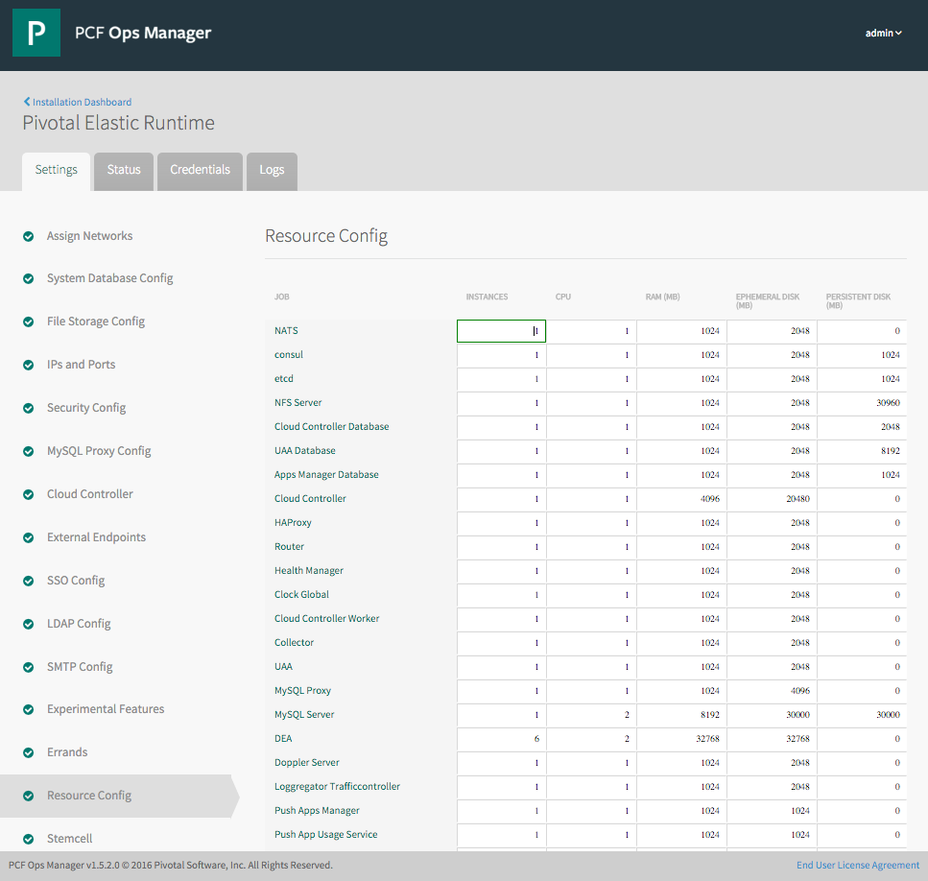
Elastic Runtime Tile
Web form allowing an operator to scale components both
vertically (CPU, RAM, Disk) and
horizontally (number of instances).
This results in updating the deployment manifest followed by a “bosh deploy.”
Notes:
http://docs.pivotal.io/pivotalcf/customizing/index.html
We can explain quiet a bit on the ERS image. We can highlight the wizard like functionality by showing the settings steps on the left and the monitoring capabilities on the status and logs tabs. We can also talk about credential management for the components of ERS. The setting step selected is the resource config which we can talk about scaling components and HA deployments.

Slide 5






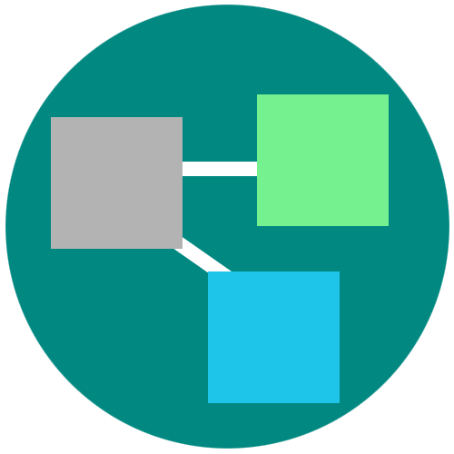
Platform Runtime – Application Centric
Roles and Policy
Log aggregation
Security and Isolation
APM
Scaling
APPLICATION
Blue green deployment
Health management
Notes:
Its no longer about running an app on a single VM and relying on Vm centric scaling to manage demand.
PCF provides an abstraction layer that allow you to scale out with application containers as the unit (not the VMs). So…You will no longer need to know which VM or where your app container is running because PCF surfaces visibility at the app layer and not though infrastructure constructs like VMs. We call this an application “dial tone”
This along with a high degree of automation with no additional wiring needed is what radically simplify application operations
You can do really rapid blue-green deployment, A/B testing, health management needed for the resiliency and fast updates of your apps. It has built in features that wrap full lifecycle management like APM, log aggregation. Policy enforcement and role based access to resources are all integrated and can be set.
Everything that you need for an enterprise grade distributed app container management system is right there.

Slide 6
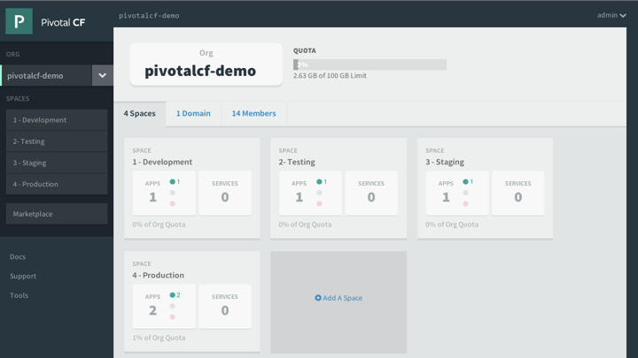
Platform Runtime - Apps Manager
Manage Organizations, users, applications and Spaces
Monitor applications logs, services and routes
Access Service Marketplace, create services and bind to applications
Notes:
http://docs.pivotal.io/pivotalcf/console/index.html
This picture allows us to walk thru the basics of Apps Manager. PCF Elastic Runtime self-service UI. ERS is a multi-tenant platform that can be logically divided into Organization and further into spaces. Quotas ensure resources are managed and Spaces further divides organization to manage and control access to application and services.

Slide 7
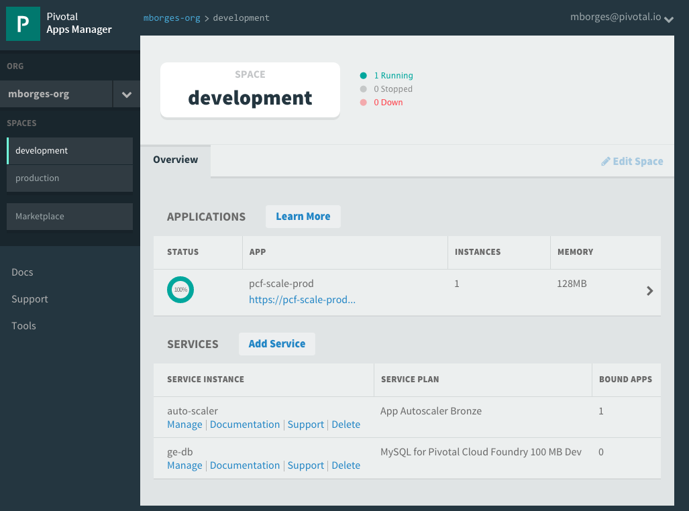
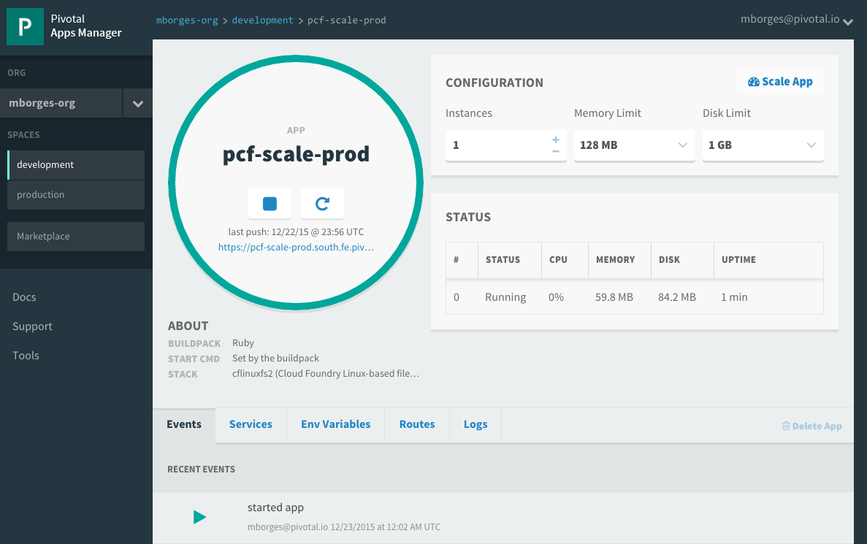
Pivotal Apps Mgr. – App View
Drill into a space to see all application and services instances
Then drill into an application to see configuration, status, event, logging, routes, environment variables and service instances bound to the application
Notes:
http://docs.pivotal.io/pivotalcf/console/index.html
This picture allows us to show the space view that provides quick overview of all applications and services target to it. Further application detail can be obtain by drilling into specific application. Notice that services can be managed via the quick manage link. The number of bounds apps is also showed.

Slide 8
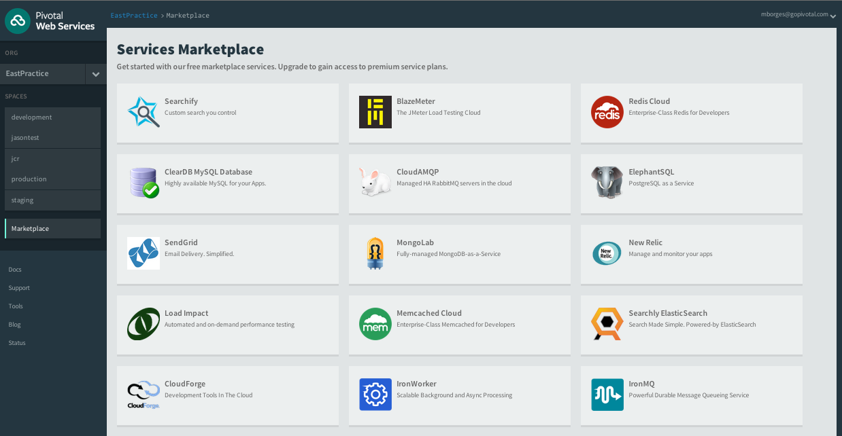
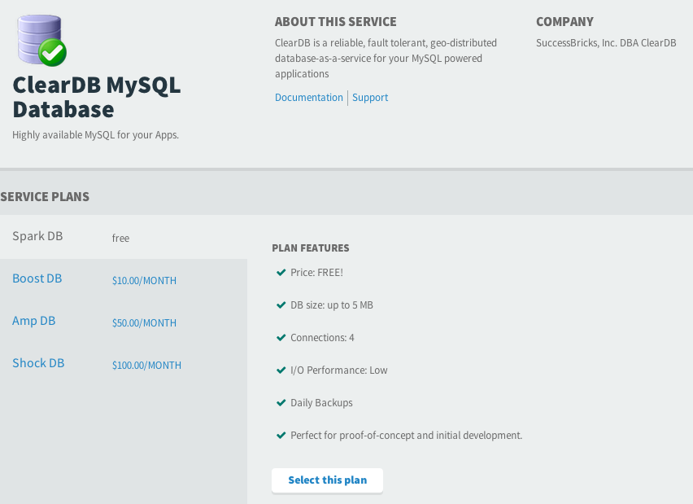
Services Marketplace
Service is an external application dependency or components such as:
Database or Message Queue
Quickly access platform services via marketplace
Create services instances based on service plans
Bind Services to Applications
Notes:
https://docs.pivotal.io/pivotalcf/devguide/services/
TDB – Change the image to be consistent to the Ops Manager Image – maybe use the pivotal documentation
*** This is part of Apps Manager ***
The marketplace is a ERS concept. Typically Ops Manager Services tiles register their service brokers (keep it simple since services were not introduced yet) with the marketplace. The service broker publishes a catalog of service plans that can be consumed by applications deployed in ERS via Apps Manager.

Slide 9
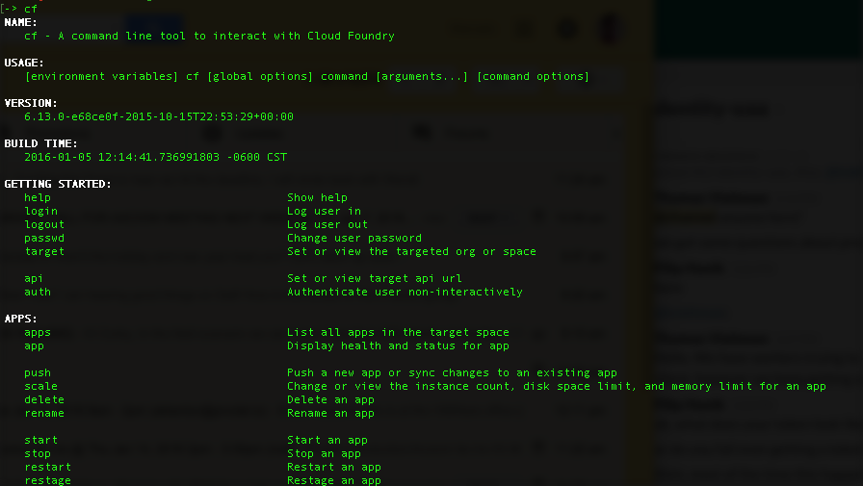
CLI – Command Line Interface
Command line utility providing easy access to the Pivotal CF commands.
Scriptable
Fully documented (cf –help)
Notes:
http://docs.pivotal.io/pivotalcf/console/index.html

Slide 10
PCF architecture
Notes:
(bold moves)
2015 – This is..
The year where we see a level of adoption of our products and services that propels us to becoming an ipo-worthy company
This is..the year where our great vision becomes a reality in production environments at the most important companies and organizations in the world.
This is the year that we show and teach our customers and partners the power and opportunity that building great software brings.

Slide 11
Elastic Runtime Architecture
Turnkey, Fully automated Cloud Native Platform
Scalable runtime environment, extensible to modern framework and languages
Instant scalable with updates and upgrades with no downtime
Deploy, scale and manage applications with services
Pivotal CF Elastic Runtime
Dynamic Router
ROUTING
OAuth 2.0 Server (UAA)
Login Server
AUTHENTICATION
Cloud Controller
etcd
Auctioneer
APP LIFECYCLE
Brain / BBS
MESSAGING
Service Brokers
CELL
Blob Store
APP STORAGE
& EXECUTION
Garden
Build Packs
Sys Log
Collector
App Log
METRICS & LOGGING
Pivotal CF Ops Manager / BOSH
Notes:
TDB: Sort out the box component to be represented at a high-level. For example, should we brake down the Diego Brain and Cell?
[Cornelia Notes] This should be used as a transition to say “the elastic runtime deployed a cluster of VMs – each of the green boxes is one, usually deployed in duplicates – and BOSH/Pivotal CF OpsManager is what we will talk about now…
*** Original bullets points ***
Turnkey, fully automated Platform-as-a-Service
Scalable runtime environment, extensible to most modern frameworks and languages running on Linux
Instant expansion or upgrade with no downtime
Deploy, scale and manage applications with bindable services using simplified semantics and APIs

Slide 12

Deploying an Application
Blobstore
Service
credentials
Upload app bits and metadata
DB
push app
+ app MD
Cloud Controller
Service Broker Node(s)
Create and bind services
Stage application
Deploy application
Manage application health
Router
Container Management - DIEGO
Cell
DEA
Brain
DEA
DEA
+
=
Notes:
We keep the cf push workflow simple and don’t get into the details of DIEGO. We only keep the BRAIN and Cell.
Cloud Foundry PaaS – Pushing an Application with Diego
App deployment: what has changed?
1- Domain specific (notion of apps) -> Abstractions (notions of LRPs and Tasks). App staging is a Task. App start is launching a LRP.
2- Platform specific (linux) -> Supporting multi platform (Windows & Linux) enabling running also .NET apps, thanks to our new Container implementation: Garden
What’s more, there is a 3rd workflow supported: Docker on Linux
3- New Auction-based workload scheduler: Cloud Controller no longer in charge of deciding where AIs are spun up. Auctioneer manages the process running an auction, making it more optimized.
With Diego in place, more loosely-coupled components take part in the process, stripping down the Cloud Controller from too many previous responsibilities, making it easier to maintain and evolve the entire architecture.
The Cloud Controller handles the routing of client requests internally through the Cloud Controller Bridge. It also manages the Blobstore to store packages and droplets and the DB to store App Metadata and Service credentials. Blobstore could be internal or external, depending on the setup.
A service gateway provides an interface for services (native or external).
More in the next slide about the Cloud Controller Bridge (CC-Bridge), the Bulletin Board System (BBS) and the Auctioneer in the next slide
Apps run in a CELL, part of the new Cloud Foundry Runtime, called Diego
Routers manage application traffic.
Diego handles all health management for apps (now LRPs), through a series of single-purpose components: Nsync (part of the CC-Bridge), BBS (part of Diego DB) and the Converger (part of the Diego Brain)
Apps are accessed directly through the router while web and CLI clients (e.g., vmc, STS) access Cloud Controller via RESTful services.

Slide 13
Staging an Application
Blobstore
DB
Cloud Controller
Cell
System
Buildpacks
Detect
Compile
Upload
Router
Yes
No
+
=
Platform Runtime
Notes:
The purpse is to simple explain our staging process and introduce buildpacks. We’re not getting into the details of DIEGO.
https://github.com/cloudfoundry-incubator/diego-design-notes#app-lifecycles

Slide 14
Demo Spring Travel
Notes:
The purpse is to simple explain our staging process and introduce buildpacks. We’re not getting into the details of DIEGO.
https://github.com/cloudfoundry-incubator/diego-design-notes#app-lifecycles

Slide 15
Pivotal Cloud Foundry Architecture
Platform Runtime
Services
Routing
Container Scheduling
Service Discovery
Configuration
Database
Application Framework
Big Data
12 Factor Apps
Microservices
RESTful Services
Circuit Breakers
Object Storage
Mobile
Spring Boot
Ruby on Rails
Node.js
.NET
Build CI
Logging & Metrics
Messaging
User Provided
Operations
Zero Downtime Deployments
Failover & Recovery
Scaling
Security Patching
Platform
Upgrades
Notes:
Before diving into BOSH we introduce the major components of the platform. Then we explain the platform infrastructure automation capabilities in the context of our structured (or opinioned) platform. The following BOSH sections would explained in more detail.
PCF is made of 3 major components – Operations (Ops Manager), Platform Runtime (Elastic Runtime) and Services. All, mostly deployed, by BOSH
Now we’ll briefly talks about the components

Slide 16
Buildpacks
Notes:
THIS SECTION INCORPORATES SLIDES FROM “PCF Basics and Arch 301” Deck

Slide 17
Topics
Why Buildpacks?
What is in a Buildpack?
Available Buildpacks
Buildpacks for Admins

Slide 18
Developer Haiku using Cloud Foundry
Cloud Foundry Haiku from @onsijoe
”Here is my source code
Run it on the cloud for me
I do not care how”

Slide 19
Why Buildpacks?
Single tool-chain to detect, stage and run any application
Reduce dev technical/security debt with buildpacks. Devs build apps, buildpacks build/maintain rest of the stack.
Buildpacks can provide an appropriate runtime and additional libraries for the apps to be run if needed.
Buildpacks package app and runtime into a single runnable artifact. The Platform then runs this within a new Linux container.
Platform managed rootfs is mounted in every container when using buildpacks as opposed to dev’s creating/maintaining own Docker images with their choice of Linux.
Helps devs be cloud native by adopting 12 factor guidelines

Slide 20
Ingredients of a Buildpack Container
Buildpacks are scripts that can detect applications, install middleware runtimes and package app bits into it.
Also provides scripts to run the application with its dependencies.
Buildpack
App Bits + Middleware
Every container receives a Filesystem image purpose built for CF.
Only necessary dependencies are added to reduce the attack surface and maintainability of these dependencies for security patches
rootfs
Filesystem
Buildpack Container
Kernel & Devices
Provides kernel and its dependencies, devices, network interfaces, semaphores(for compilers)
Primarily Ubuntu 14.04 with support for RHEL7/CentOS7 and Windows Server 2012 coming soon.
Stemcell
Courtesy, Mark Kropf’s blog - App dev’s view of CF stack

Slide 21
Bring your Container(BYC) vs Buildpacks
BYC (e.g. Docker)
Buildpack
application layer
application layer
Dev Provides
System Provides
runtime layer
runtime layer
App container
OS image
OS image
system brings fixed host OS Kernel
system brings fixed host OS Kernel

Slide 22
Day 2 Operations with Buildpacks
Buildpack
application layer
Developer/App team provided
Blue/Green Deployments
Dev Supported
Platform supported
Platform or Dev provided
CVE’s addressed by Pivotal for Platform provided
Blue/Green Deployments
runtime layer
App container
OS image
Platform provided
CVE’s addressed by Pivotal
Canary style zero downtime deployments
system brings fixed host OS Kernel

Slide 23
What is in a Buildpack?
Idea and format of a buildpack was borrowed from Heroku. Many Buildpacks supported on Cloud Foundry derived from Heroku Buildpacks.
Buildpacks are built with a simple API of three bash scripts
./bin/detect app_directory - Inspect app bits to determine type of application.
./bin/compile app_directory cache_directory - Installing the appropriate run-time, packages and libraries as well as packaging the application bits with the runtime if needed.
./bin/release - Returns a YAML payload that describes the default way of how the application needs to be started.
Usage within Cloud Foundry :-
“$ cf push app_name” – Detect scripts of the buildpacks are called to get the application type
“$ cf push app_name -b buildpack_name” – Uses the specified installed buildpack.
“$ cf push app_name -b buildpack_url” – Uses a buildpack hosted at the specified URL.

Slide 24
Basic services overview
Notes:
THIS SECTION INCORPORATES SLIDES FROM “PCF Basics and Arch 301” Deck

Slide 25
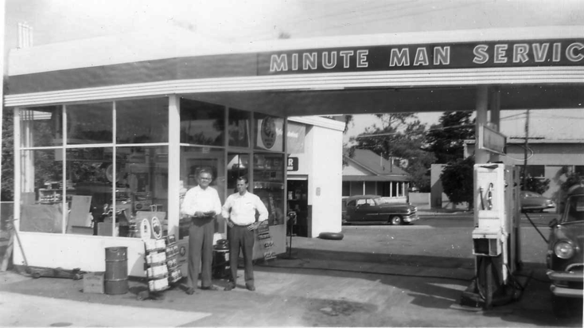
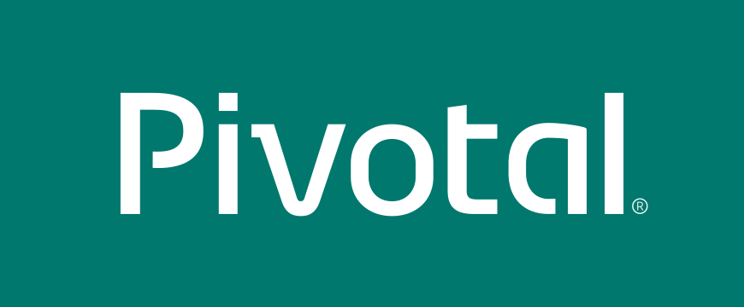
What is a Service?
Allows resources to be easily provisioned on-demand.
Typically middleware, frameworks, and other “components” necessary for applications.
Can be a persistent, stateful layer

Slide 26

2 types of Services
Managed – Fully integrated, with fully lifecycle management
User-Provided – Created and managed externally to the Platform.

Slide 27
User-Provided Service
User-provided - A user-provided service is simply a list of connection parameters that are stored in the platform and provided to an application when it binds to the service.
User-provided services are useful for quickly getting parameters to an application, without having to create a service broker and registering with it the platform. They are also helpful for services that will probably only be used once or twice.
Applications connect to the same instance.
User-provided services are created using the CF CLI’s create-user-provided-service command, which takes an arbitrary set of key/value pairs as an argument.
> cf create-user-provided-service my-old-db –p ‘{“user”:”admin”,”password”:”pwd”}’
Full instructions can be found here https://docs.pivotal.io/pivotalcf/devguide/services/user-provided.html

Slide 28
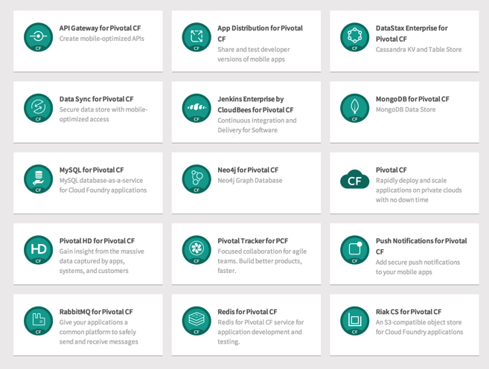
Managed Services
Managed Services are integrated with PCF by implementing a documented API.
A self-service catalog of databases, analytics and middleware technologies:
Production ready
Integrated lifecycle management
Managed credentials
Role-based access
Service Broker is a component which implements the Service API. Service brokers advertise a catalog of service offerings and service plans to Cloud Foundry.

Slide 29
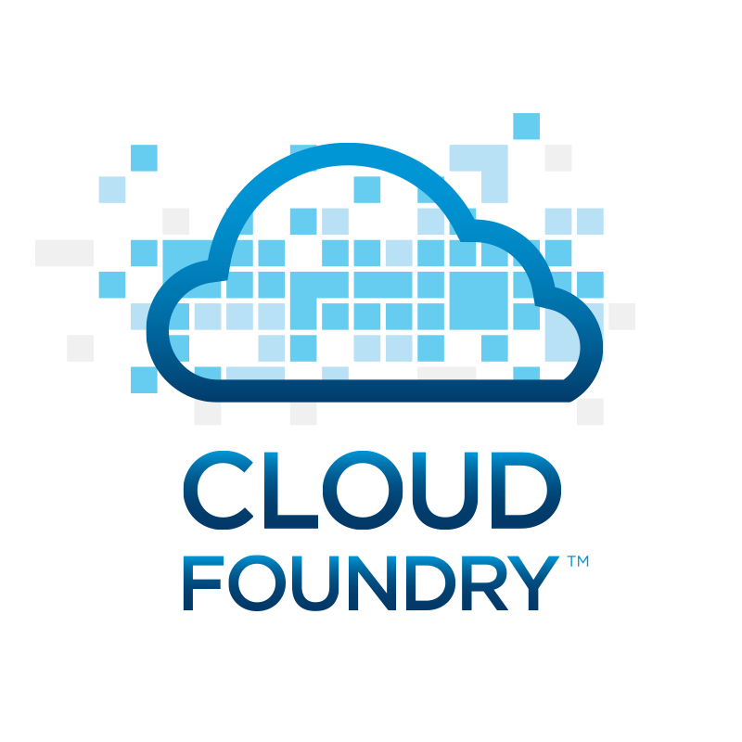
Service Creation & Binding
DB
Service
credentials
CLI
create service (HTTP)
Cloud Controller
create service (HTTP)
Service
Broker
reserve resources
Data
Service
Router
bind service (HTTP)
bind service (HTTP)
obtain connection data
Runtime
Notes:
An application runs in a DEA, which is a droplet execution agent. The Cloud Controller orchestrates the routing and lifecycle of all DEAs in the pool. Routers manage application traffic. Health Manager reports mismatched application states to the CC. A service gateway provides an interface for services (native or external). A messaging bus manages all system communication. Apps are accessed directly through the router while web and CLI clients (e.g., vmc, STS) access Cloud Controller via RESTful services.

Slide 30
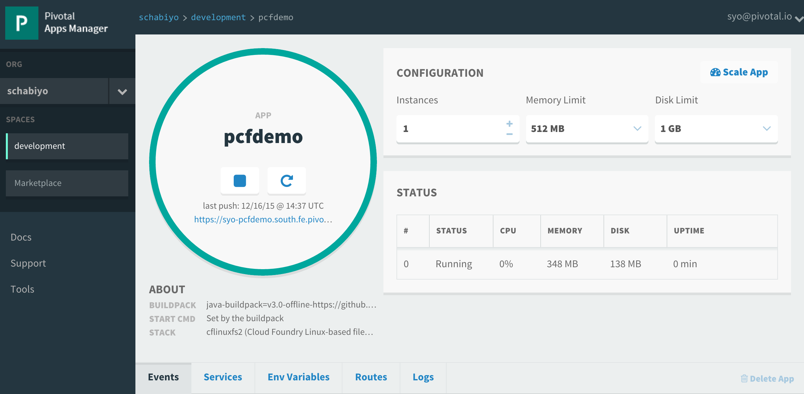
Example: Service Creation & Binding
Click on "Marketplace"
Create Service
Bind service
Restart App
Verify

Slide 31
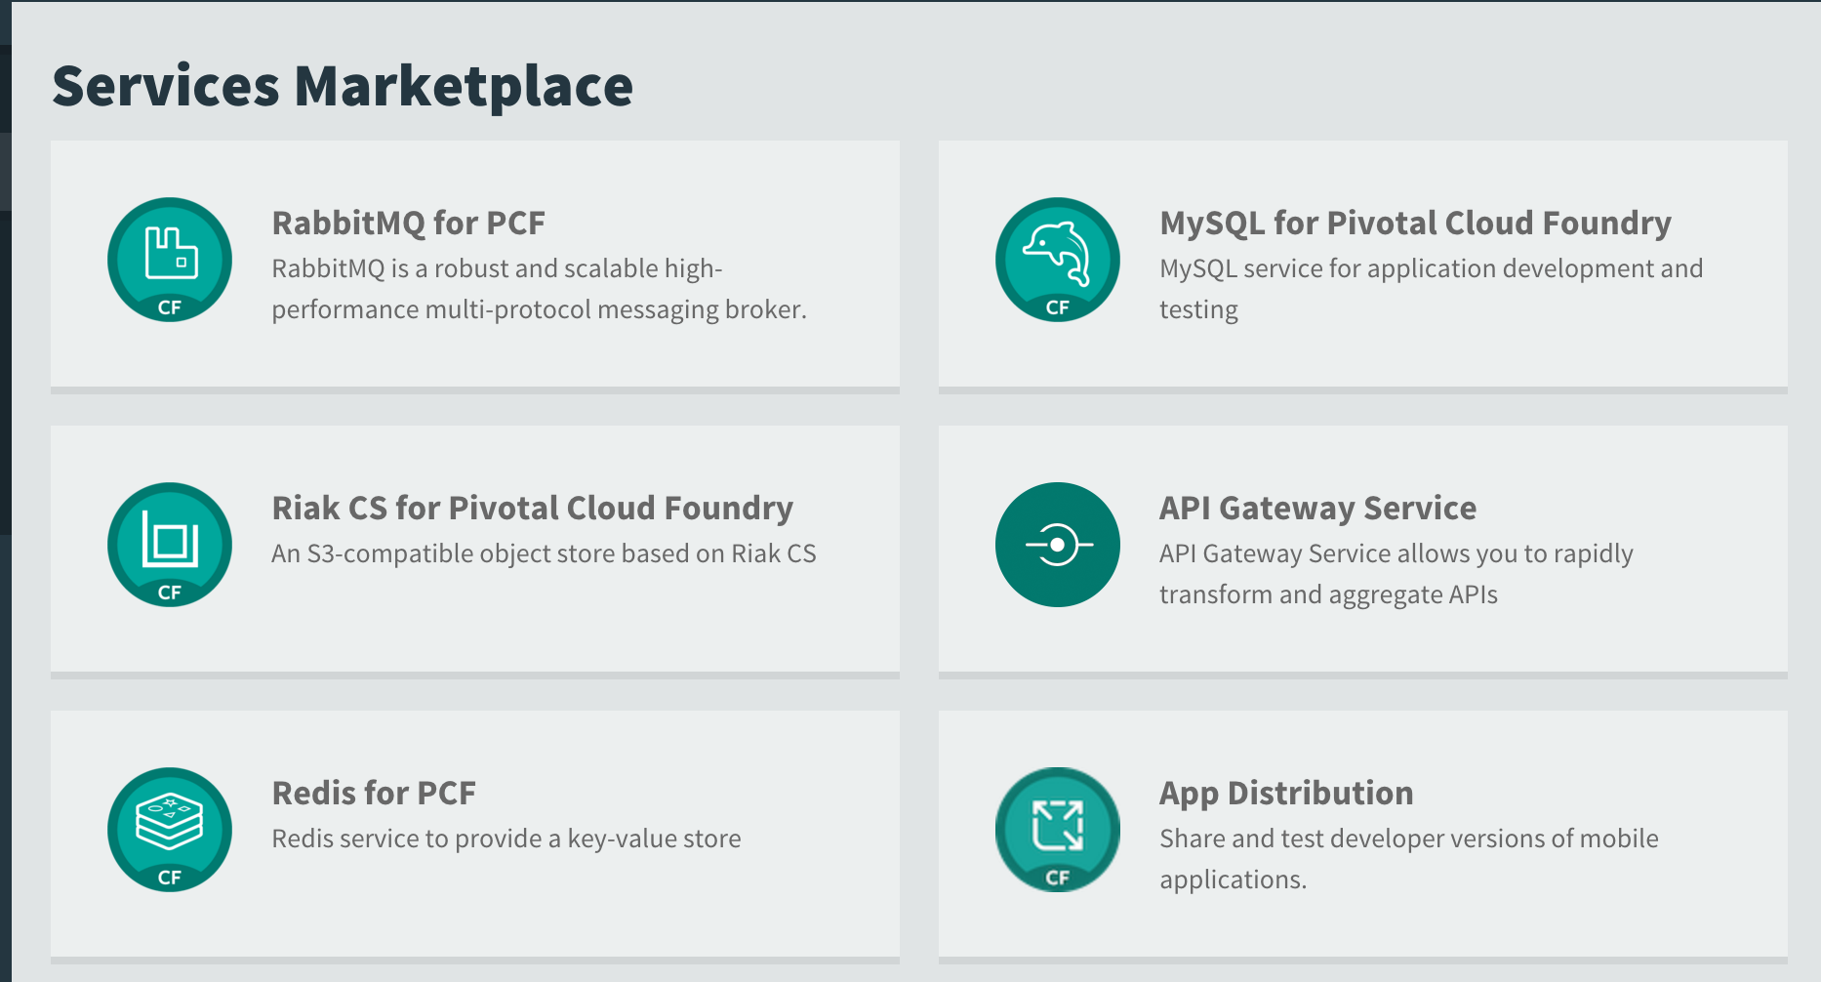
Example: Service Creation & Binding
Choose ”RabbitMQ for PCF"
Create Service
Bind service
Restart App
Verify

Slide 32
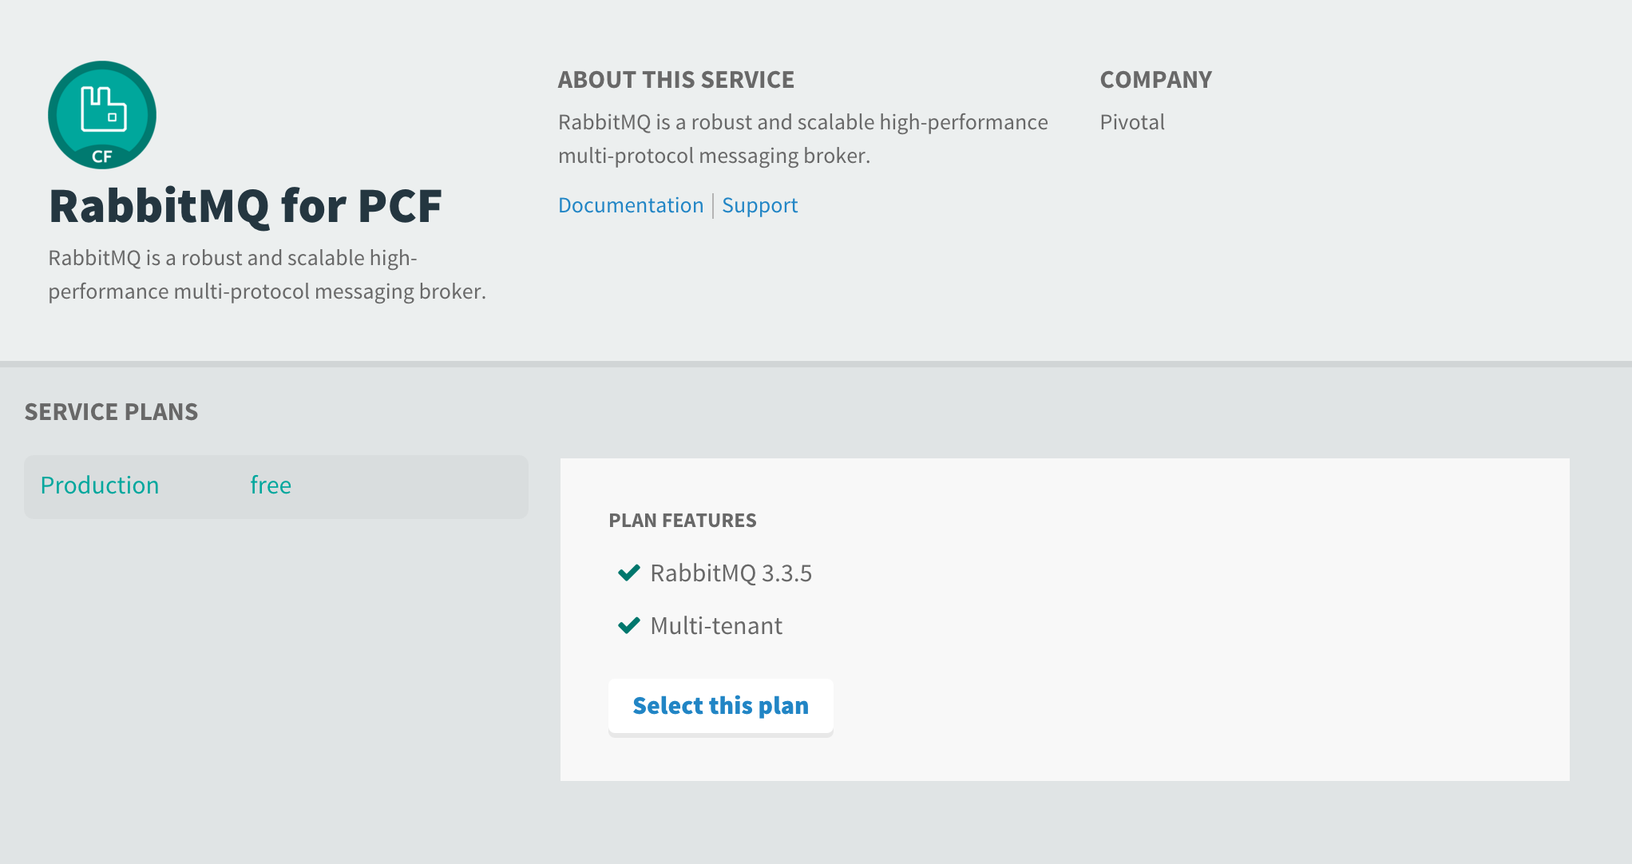
Example: Service Creation & Binding
Select the free plan
Create Service
Bind service
Restart App
Verify

Slide 33
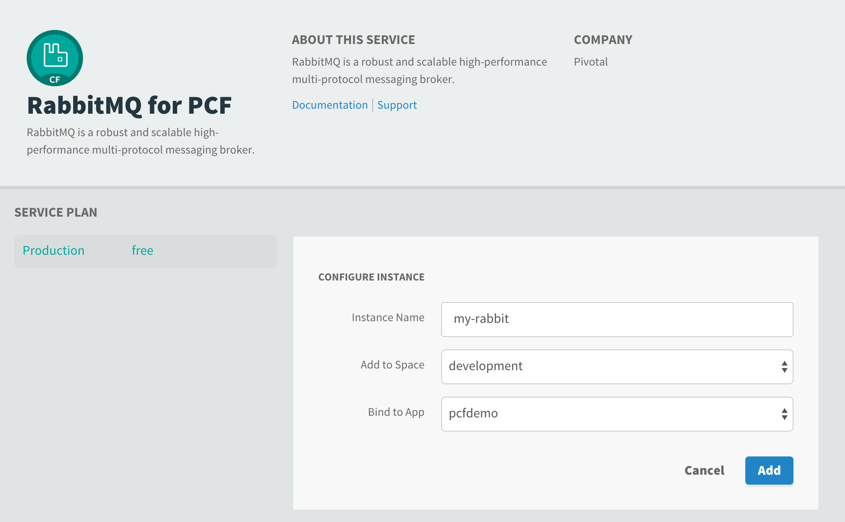
Example: Service Creation & Binding
Give it a name and bind it to your application
Create Service
Bind service
Restart App
Verify

Slide 34
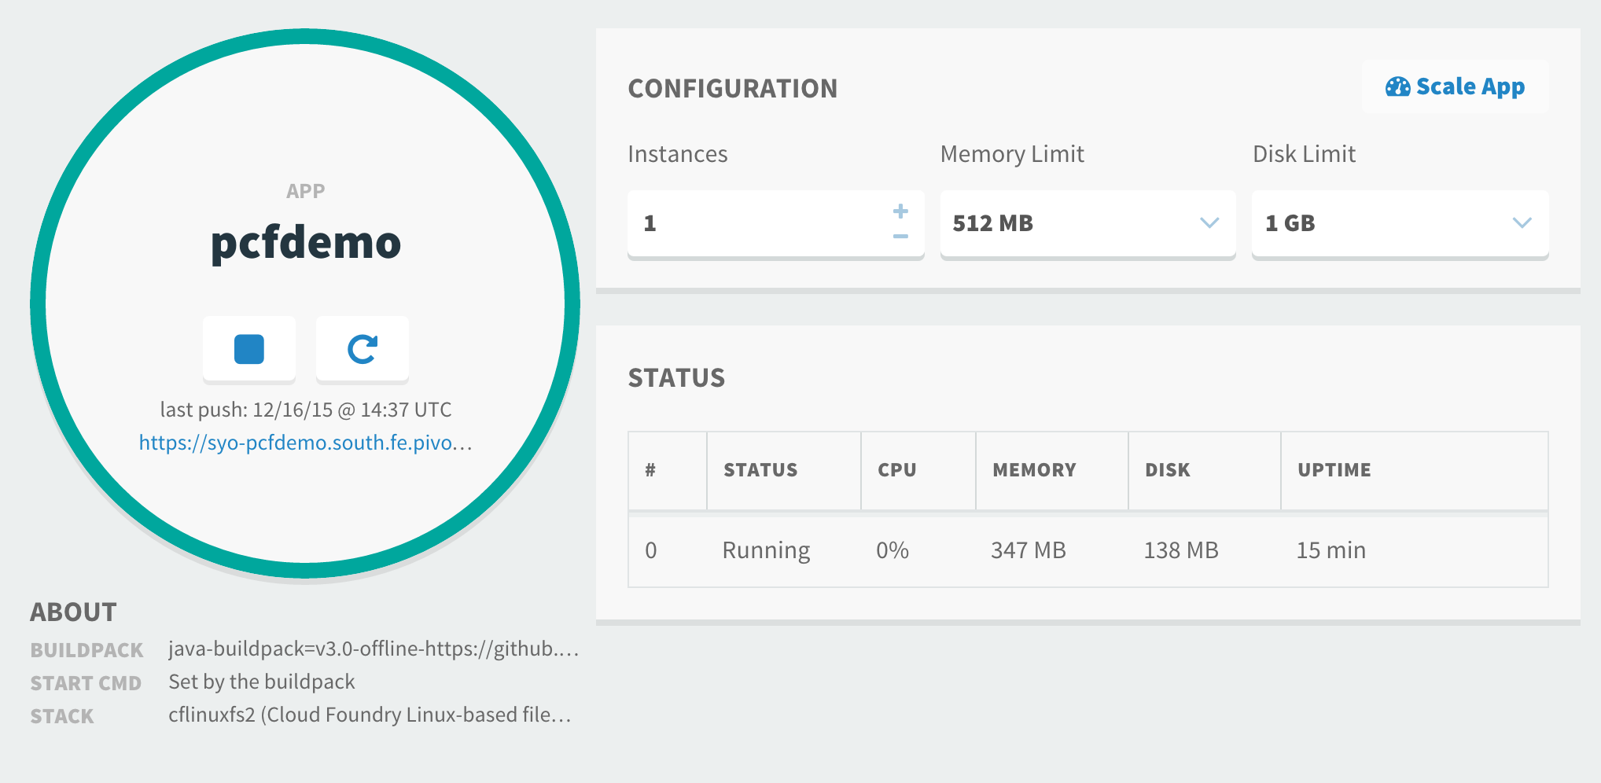
Example: Service Creation & Binding
Create Service
Bind service
Restart App
Verify

Slide 35
CF Push, Bind and scale
Notes:
THIS SECTION INCORPORATES SLIDES FROM “PCF Basics and Arch 301” Deck

Slide 36
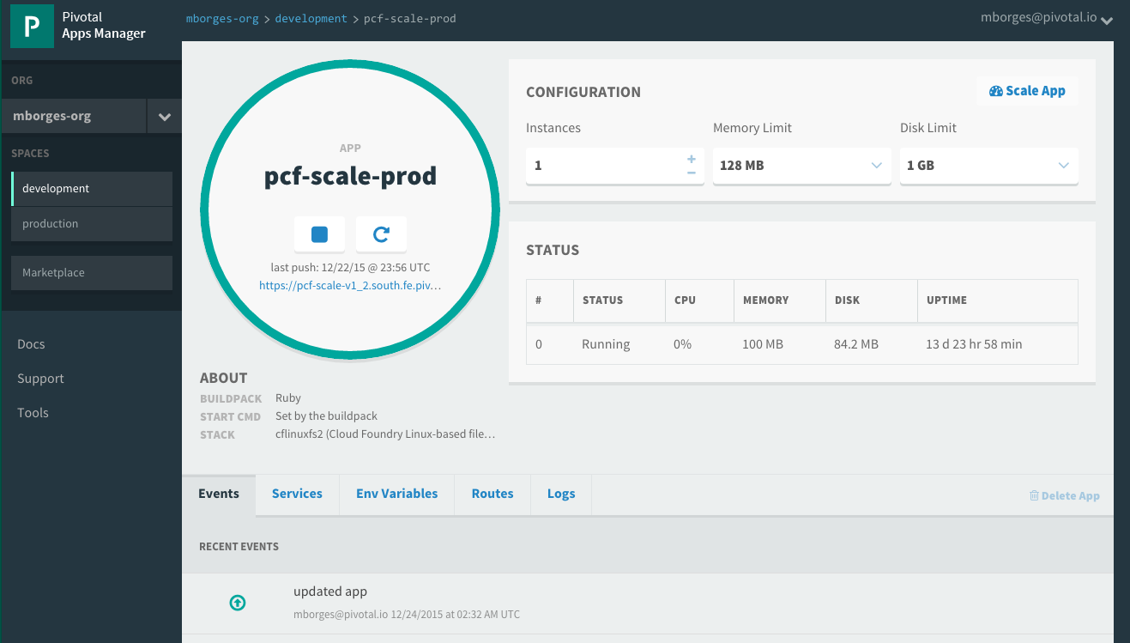

Getting your application to scale
Can be done via CLI:
At deployment time (via manifest.yml or as a modifier to cf push)
During run time without interrupting operations (via cf scale --instances 10)
Can also be done via Apps Manager
© Copyright 2013 Pivotal. All rights reserved.
Notes:
TDB: Update picture – what about slide showing visually

Slide 37
The App-Container Approach - Scaling
Blobstore
Cloud Controller
Container Management - DIEGO
Router
Access App
Brain
Cell
Cell
Cell
Platform Runtime
Notes:
https://github.com/cloudfoundry-incubator/diego-design-notes
At the core of Diego
A distributed scheduling algorithm which orchestrates where containers go and hence where application instance processes are run
Optimizing for application workloads
Implements Demand Driven scheduling of workload
Auctioneer says "I have N pieces of work, who wants them?"
Worker cells then join an auction and the winning cell of each auctioned-off piece of work gets that piece of work
Components of Diego
Tasks & Long Running Processes (LRPs)
Tasks: are processes that are run once and have a finite running time. This might be a script or job to process a piece of data
LRP: This might be a web-server or some other service that continuously accepts input and processes
Tasks are not included in Auction
Cells
Cells are where the Tasks and LRPs are run
These are most analogous to DEAs in the current Cloud Foundry architecture.
Generally one Cell per VM
Brain – implements the core scheduling (auction algorithm) functionality of Diego
Bulletin Board System/Store (BBS)
Where state of Diego cluster is stored
Up to date cache of cluster state
“Holds” CF actions
Start/Stop instances
Start one-off task processes
Backed by ETCD which acts as consistent store
Components of Diego Brain
Auctioneer – holds auctions for LRPs and Tasks
Also determines which instances are removed when scaling down
Converger - Keeps cluster state consistent using eventually consistent model
Ensures cluster state is consistent with the desired state, that is, performs convergence
Provides fault tolerance for Tasks and LRPs
Updates BBS with state of cluster
Places requests on BBS
Metric Server – Reads from Metron agents, publishes them to Doppler
Components of Diego Cell
Rep - Represents Cell in Diego
Mediates all communication with BBS where cluster state is maintained
Participates in auction to accept Tasks/LRPs
Runs Tasks & LRPs by working with Executor
Executor –
Implements HTTP API to Create and Delete Containers
Implements Executor Actions such as Run, Download, Upload, Parallel etc
Streams Stdout & Stderr to Metron agent running in the Cell
Garden – the Linux container for Diego
Garden API – the Linux Garden API implementation
Garden-Linux – the Linux container backend implementation
Isolates network, disk, memory, CPU; performs resource management
Runs droplets, tasks, other containers (Docker)
Metron Agent - Forwards application logs and application/Diego metrics to doppler (loggregator)

Slide 38
, Manifest & CC API
Notes:
THIS SECTION INCORPORATES SLIDES FROM “PCF Basics and Arch 301” Deck

Slide 39
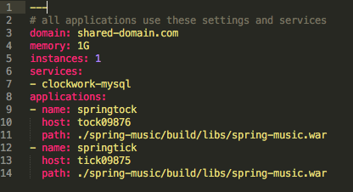
Manifest Files
Application manifests tells cf push what to do with applications
From how many instances to create and how much memory to use.
Help automate deployment, specially of multiple apps at once
Can list services to be bound to the application
YAML format – http://yaml.org
Notes:
https://docs.pivotal.io/pivotalcf/devguide/deploy-apps/manifest.html
YAML format - Default name is manifest.yml

Slide 40
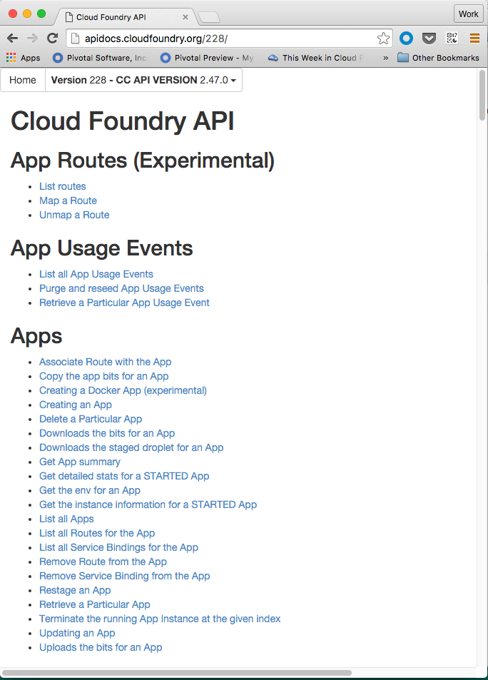
Cloud Controller API
Cloud Controller component of Elastic Runtime manages all Cloud Foundry APIs
CF CLI and other clients like Apps Manager directly call this API
Before accessing the CC API, you must get an access token from the ERS component called User Account and Authentication (UAA) server
http://apidocs.cloudfoundry.org
Notes:
http://docs.pivotal.io/pivotalcf/console/index.html

Slide 41
CLI – Command Line Interface
Command line utility providing easy access to the Pivotal CF commands.
Scriptable
Fully documented (cf –help)
Notes:
http://docs.pivotal.io/pivotalcf/console/index.html

Slide 42
LOgging
Notes:
THIS SECTION INCORPORATES SLIDES FROM “PCF Basics and Arch 301” Deck

Slide 43
Log Streaming and Aggregation
App Developers can tail their application logs or dump the recent logs from the CF CLI, or stream these to a third party log archive and analysis services
Operators and administrators can access the Loggregator firehose, the combined stream of logs from all apps, plus metrics data from CF components
Operators can deploy ‘nozzles’ to the firehose. A nozzle listens to the firehose for specified events and metrics. E.g syslog or datadog nozzle
Notes:
https://docs.pivotal.io/pivotalcf/loggregator/nozzle-tutorial.html
Avery Application instance starts streaming logs immediately
“Loggregator” component aggregates logs and streams back to different outputs
Streaming can be send directly to Splunk or other log aggregation and analytics tools

Slide 44
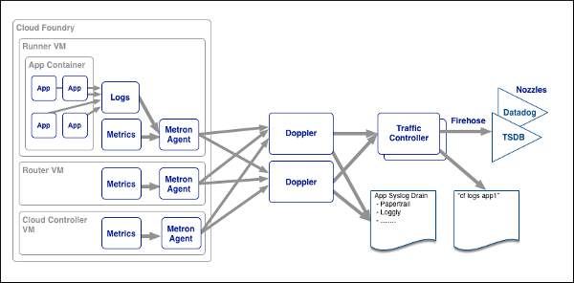
Loggregator Components
Notes:
https://docs.pivotal.io/pivotalcf/loggregator/architecture.html

Slide 45
Domains and routes
Notes:
THIS SECTION INCORPORATES SLIDES FROM “PCF Basics and Arch 301” Deck

Slide 46
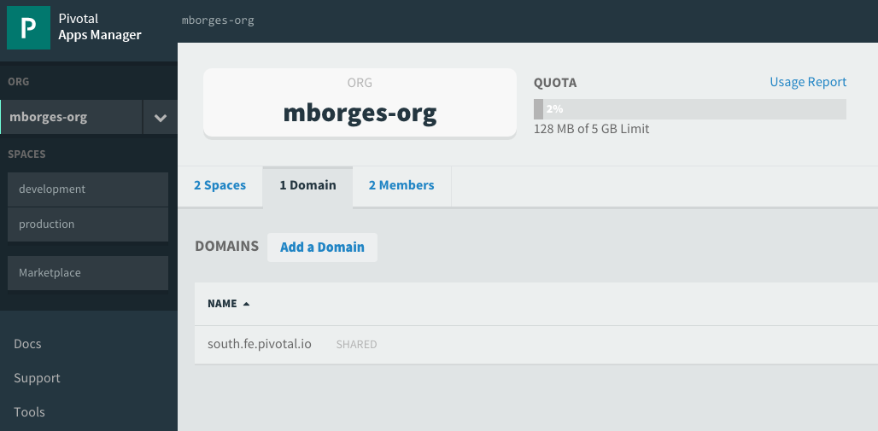
Domains
Each Cloud Foundry installation has a default app domain
Domains provide a namespace from which to create routes
Requests for any routes created from the domain will be routed to Elastic Runtime.
Domains can be shared or private in regards to PCF organizations
Notes:
https://docs.pivotal.io/pivotalcf/devguide/deploy-apps/routes-domains.html
Picture of PCF architecture HAProxy and Router using domain namesdns

Slide 47
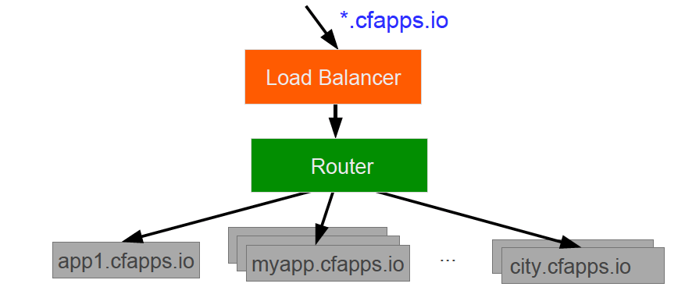
A wildcard entry (*) is added to the DNS for the app domain
That DNS entry points to a load balancer (or Cloud Foundry’s HA Proxy), which points to the Cloud Foundry’s Router
The Router uses the subdomain to map to application instance(s)
Notes:
https://docs.pivotal.io/pivotalcf/devguide/deploy-apps/routes-domains.html
Picture of PCF architecture HAProxy and Router using domain namesdns

Slide 48
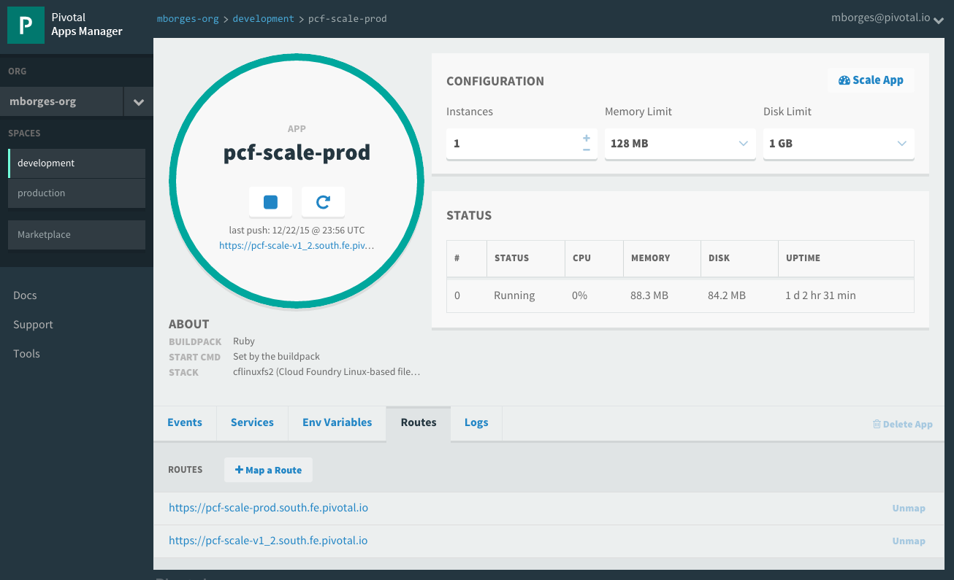
Routes
HTTP requests are routed to apps pushed by associating an application with a URL, know as route
Many apps can be mapped to a single route resulting in load balanced requests
Routes belong to a space
Application can have multiple routes
Notes:
https://docs.pivotal.io/pivotalcf/devguide/deploy-apps/routes-domains.html
TDB: Consider adding a picture instead of just showing Apps Manager

Slide 49
Demo Scale
Notes:
https://docs.pivotal.io/pivotalcf/devguide/deploy-apps/routes-domains.html
TDB: Consider adding a picture instead of just showing Apps Manager

Slide 50
Basic troubleshooting
Notes:
THIS SECTION INCORPORATES SLIDES FROM “PCF Basics and Arch 301” Deck

Slide 51
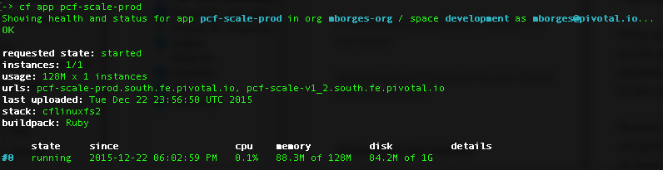
Health
Usage: cf app APP…
Show the running instances and health information for one or more applications
Example:

Slide 52
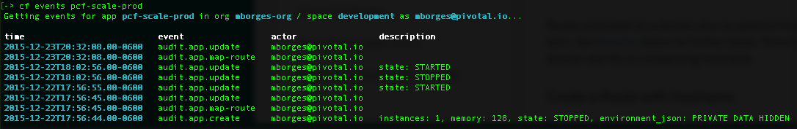
Events
Display application instance events (updates, crashes, …)
Usage: cf events [APP]
Example:

Slide 53
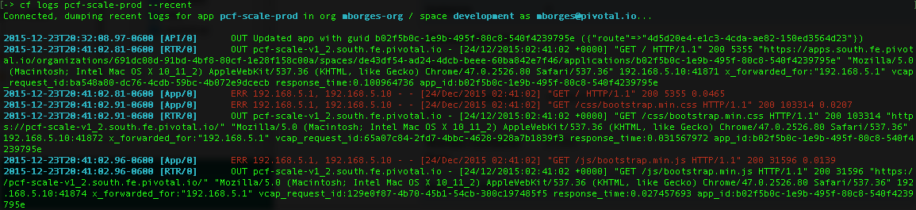
Logs
Print out an app's logs
Usage: cf logs [APP] Options: --recent Recent logs
Example:

Slide 54
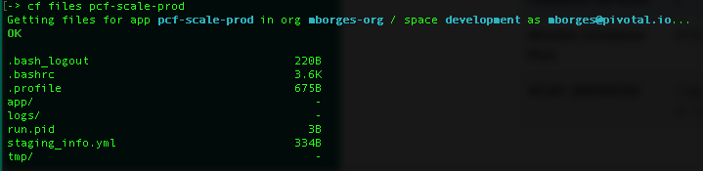
Files
Print out a list of files in a directory or the contents of specific files
Usage: cf files APP_NAME [PATH] Options: -i Instance
Example:

Slide 55

Diego for PCF SSH access to containers
> cf ssh my-awesome-app
SSH Proxy Server
✓ Authenticate
✓ Locate target container
✓ Connect to the ssh daemon
✓ Manage communication
DEA /CELL
App
App
App
App
Notes:
*Note: Make sure to mention that this functionality should be used only in case deeper troubleshooting is required. The integrity of the platform has to be kept…we don't want to enable snowflakes. Operations can control ssh access…see more details below:
Diego SSH is composed by:
Implementation of an ssh proxy server
A SSH daemon
CF CLI plugin
The SSH proxy is the user accessible endpoint. It is responsible for: authentication, locating target container, establish the connection to the daemon running inside the container and after the connection is established, it manages the communication between user’s ssh client and container’s daemon.
SSH daemon supports:
Command executions
Interactive shells
Local port fowarding
SCP
It is made avalalble on a file server and can be donwloaded for Diego LRPs that want to use it. For CF apps the daemon will be downloaded as part of the lifecycle bundle.
Config tru CLI:
App: enable_ssh
CF space: allow_ssh
OPS Manager:
CC: allow_app_ssh_access

Slide 56
Blue/green deployment and db migration
Notes:
THIS SECTION INCORPORATES SLIDES FROM “PCF Basics and Arch 301” Deck

Slide 57
Blue-Green Deployments
Blue-Green deployment is an approach to upgrading application with minimal downtime.
It also enables easy rollback to the old version if the new version experiences problems
It works by keeping both versions online, and switching from the old version to the new version
live
traffic
app 1.0
app 1.0
live
traffic
app 1.1
app 1.1
Before
After
Notes:
https://docs.pivotal.io/pivotalcf/devguide/services/migrate-db.html
IMAGE FOUND ON GOOGLE – check

Slide 58
Blue-Green Deployments using Routes
Main idea: you always want myapp.cfapps.io to be good
Use routes to achieve this
Because you are in a single space, multiple application can use the same routes
myapp.cfapps.io
myapp.cfapps.io
app 1.0
app 1.0
app 1.0
myappdev.cfapps.io
app 1.1
myapp.cfapps.io
app 1.1
myapp.cfapps.io
app 1.1
Before
(working on version 1.1)
During
(version 1.1 is ready)
After
(done with version 1.0)
Notes:
https://docs.pivotal.io/pivotalcf/devguide/services/migrate-db.html
IMAGE FOUND ON GOOGLE – check

Slide 59
Slowly Turning on Traffic using Instances
Start with four instance of blue, one instance of green
80% of traffic will use version 1.0
Decrease blue instance, increase green instances as confidence builds
app 1.0
myapp.cfapps.io
app 1.0
app 1.0
app 1.0
app 1.1
app 1.1
myapp.cfapps.io
app 1.1
myapp.cfapps.io
app 1.1
app 1.1
Notes:
https://docs.pivotal.io/pivotalcf/devguide/services/migrate-db.html
IMAGE FOUND ON GOOGLE – check

Slide 60
Orgs, Spaces, Users and Quota
Notes:
Multi-tenant platform

Slide 61
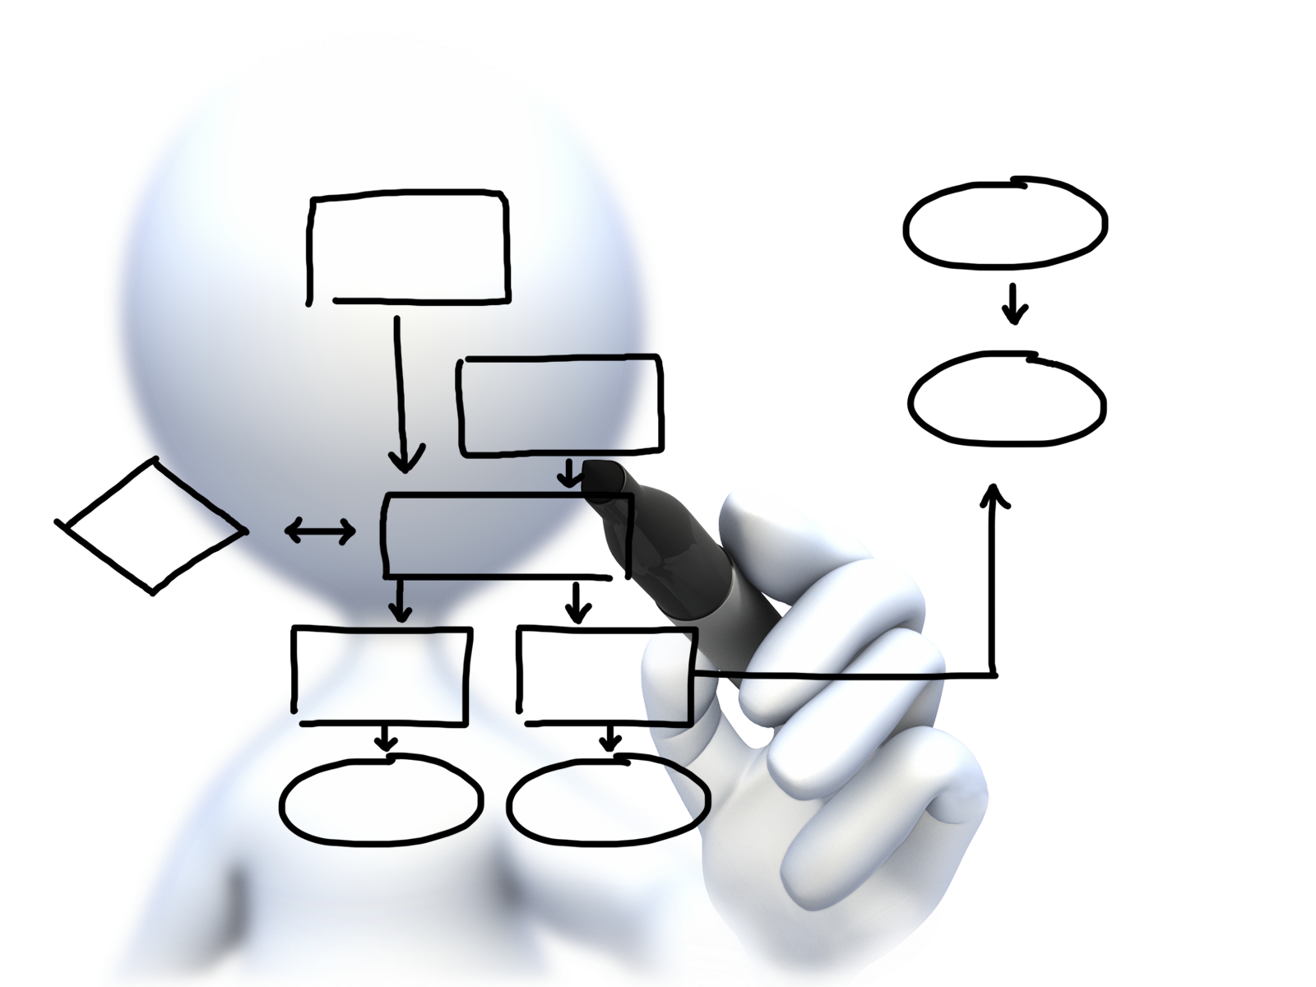
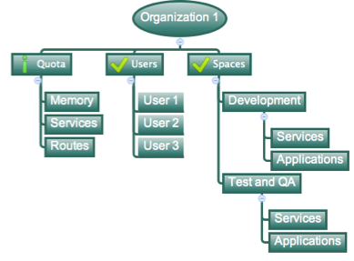
Orgs, Spaces, Users and Quotas
Cloud Foundry Installation
Notes:
https://docs.pivotal.io/pivotalcf/concepts/roles.html
Cloud Foundry uses role-based access control (RBAC), with each role graning permissions in either an org or a space.
Orgs: An org is a development account that an individual or multiple collaborators can own and use. All collaborators access an org with user accounts. Collaborators in a org share a resource quota plan, applications, services availability, and custom domains.
User Accounts: Represents an individual person within the context of a Cloud Foundry Installation. A user can have different roles in different spaces within an org, governing what level and type of access they have within the space.
Spaces: Every application and service is scoped to a space. Each org contains at least one space. A space provides users with access to a shared location for application development, deployment, and maintenance. Each space role applies only to a particular space.
Roles and Permissions (Maybe on its own slide): A user can have one or more roles. The combination of these roles defines the user’s overall permissions in the org and within specific spaces in that org.

Slide 62
Organizations
Top-most administrative unit
Logical division division within a Pivotal Cloud Foundry Install / Foundation
Typically a company, department, application suite or large project
Each organization has its own users and assigned quota
User permissions / Roles are specified per space within an organization
Sub-divided into spaces
Notes:
TDB: layout

Slide 63
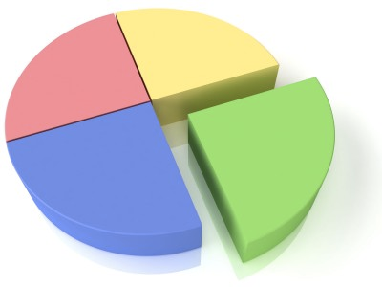
Quotas and Plans
Different quota limits (e.g. small, enterprise, default, runaway) can be assigned per Organization
Quotas defines
Total Memory
Total # of services
Total # of Routes
Sub-divided into spaces
Notes:
TDB: layout
https://docs.pivotal.io/pivotalcf/opsguide/change-quota-plan.html
Note: Documentation seems very outdated and thin on this subject. Do some research
Quota plans are named sets of memory, service, and instance usage quotas. For example, one quota plan might allow up to 10 services, 10 routes, and 2 GB of RAM, while another might offer 100 services, 100 routes, and 10 GB of RAM. Quota plans have user-friendly names, but are identified by unique GUIDs.
Quota plans are not directly associated with user accounts. Instead, every organization has a list of available quota plans, and the account admin assigns a specific quota plan from the list to the organization. Everyone in the organization shares the quotas described by the plan.

Slide 64

Spaces
Logical sub-division within an organization
Users authorized at an organization level can have different roles per space
Services and Applications are created / target per Space
Same service name can have different meaning per space
Notes:
TDB: layout

Slide 65

Users and Roles
Users are members of an organization
Usually they are operators or developers (not application end users)
Users are sent an email invite and asked to create an account
Users have specific organization and space roles
Organization roles grant permissions in an organization
Space roles grant permissions in a particular space
A combination defines the user’s overall permissions
Notes:
TDB: layout

Slide 66
Auto scaling
Notes:
THIS SECTION INCORPORATES SLIDES FROM “PCF Basics and Arch 301” Deck

Slide 67
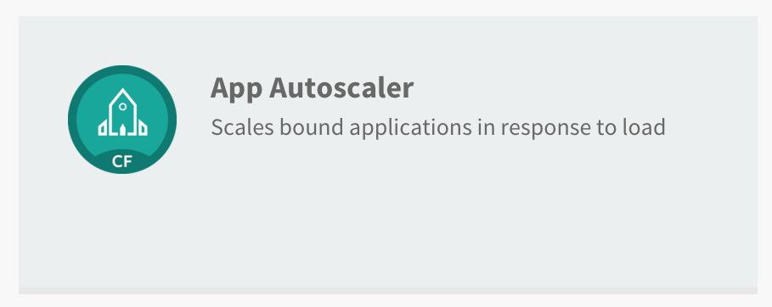
Available via the Marketplace

Slide 68
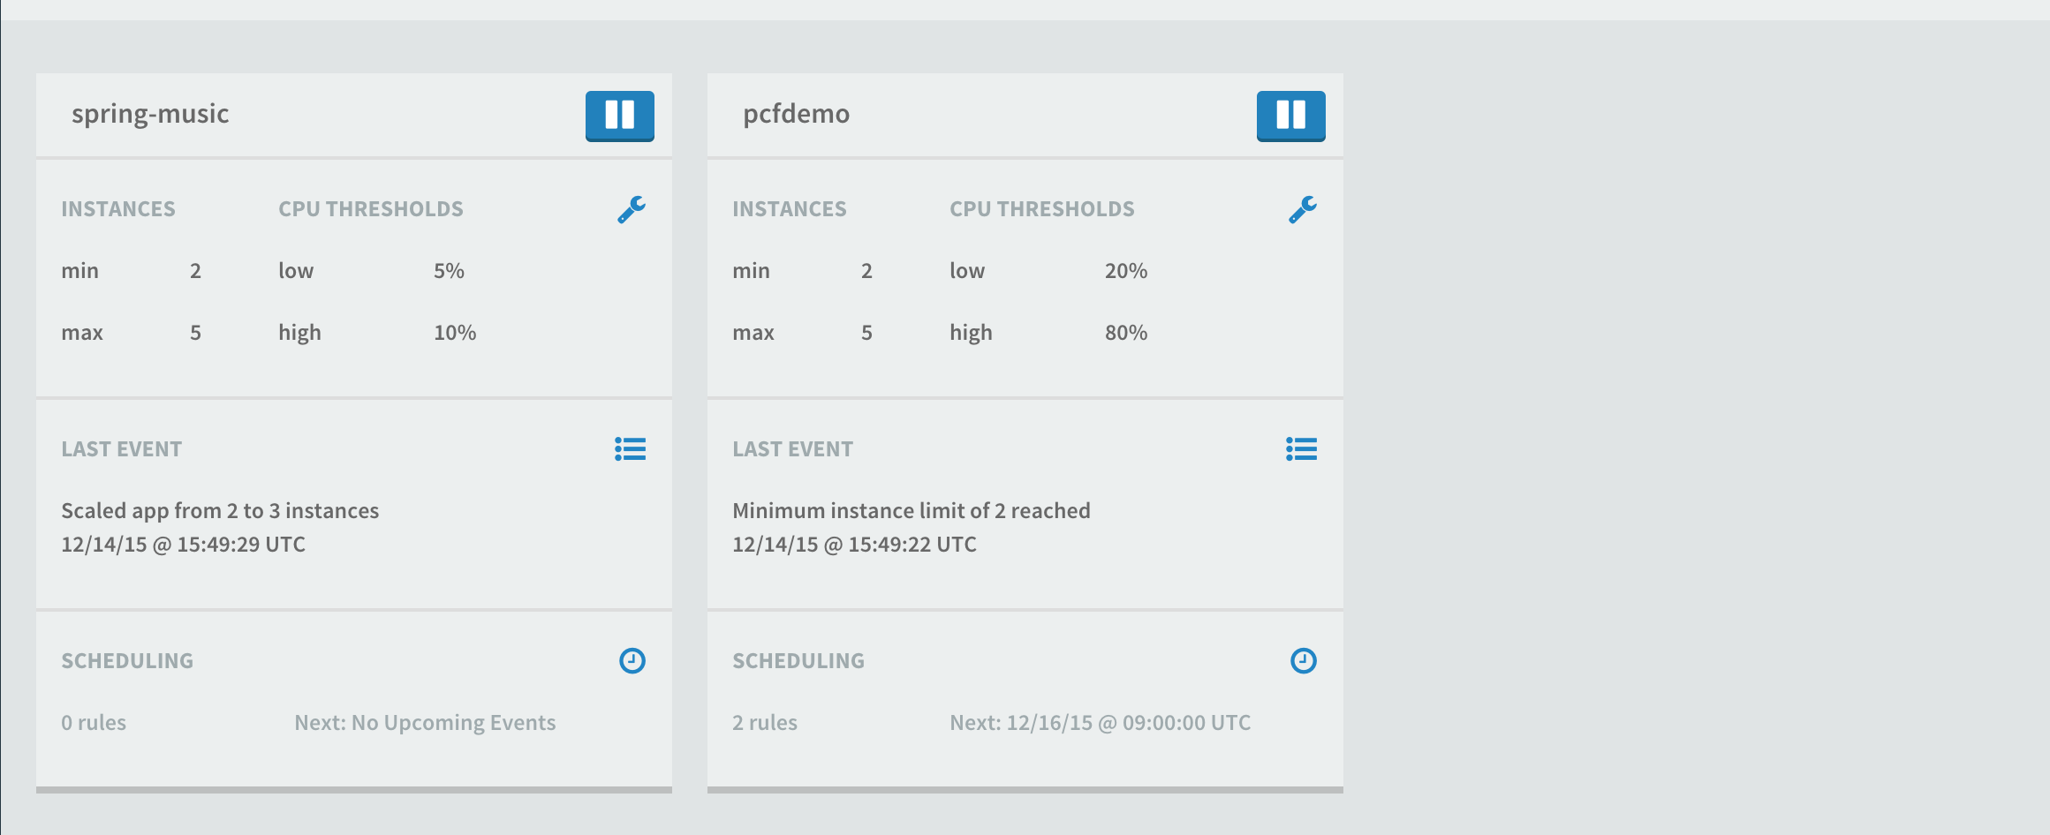
Service Management Dashboard

